Slide 1

BI-DIRECTIONAL COUNTER Using 8051 Microcontroller
Presented by:
Vineet Chaurasia(210907338)
Swastik Srivastava(210907352)
Deep Mala(210907346)
DEPARTMENT OF ELECTRONICS AND COMMUNICATION ENGINEERING
MANIPAL INSTITUTE OF TECHNOLOGY
MANIPAL – 576104, KARNATAKA, INDIA
November 2023

Slide 2
CONTENTS
Introduction
Working
Components and Software used
Block Diagram
Circuit Diagram
Simulation Softwares
Code
Simulation
Future scope and work
Conclusion
References

Slide 3
INTRODUCTION
This project utilizes an 8051 microcontroller along with sensors and display units to monitor the flow of people in two directions. It effectively counts and displays the number of people entering and exiting a specific area. This "Bidirectional Counter" is particularly useful in high-traffic locations such as libraries, museums, and malls where tracking visitor traffic is crucial.
The microcontroller is configured so that it differentiates between the entry and exit established by sensor activities. Upon a person’s entry, the entry sensor is activated, and while the exit sensor comes into play the person leaves. The microcontroller keeps distant tallies for both entries and exits
A visual representation of the count information is provided through a display unit, typically a LCD display.

Slide 4
WORKING
The circuit works on the principle of IR sensing. Infrared Sensors are devices that work with Infrared Light Source and a Photo Detector like a Photo Diode that act as a Transmitter and Receiver respectively . Two sets of these sensor pairs are positioned at two ends of the entrance to a room. They are set up so that the IR LED and Photo Diode are facing each other, with a gap in between.
Under normal conditions, when there is no obstacle or person passing through the entrance, the IR light emitted by the IR LED does not reach the Photo Diode because it's a reflective type IR sensor. Therefore, the Photo Diode does not receive the IR light, and its output remains at a logic LOW signal. When a person or object crosses the path between the two sensor pairs, it interrupts the flow of IR light from the IR LED to the Photo Diode. As a result, the Photo Diode starts receiving the IR light and begins to conduct. This change in the IR light reception causes the output of the Photo Diode to transition to a logic HIGH signal.
The outputs from each sensor pair are connected to a microcontroller. The microcontroller continuously monitors the status of these outputs. When the microcontroller detects a transition from LOW to HIGH on the output of a sensor pair, it counts this as an event. The microcontroller can be programmed to increase or decrease a count based on the direction in which the interruption occurred.

Slide 5
COMPONENTS AND SOFTWARE USED
AT89C51(8051-based Microcontroller)
8051 Programmer
IR Sensors
LED Strip
Relay
9V Battery
10 micro-farad electrolytic capacitor
10 kilo-ohm resistors
11.0592 MHz crystal
33 pico-farad ceramic capacitors
16 x 2 LCD Display
10 kilo-ohm potentiometer
Keil
Proteus

Slide 6
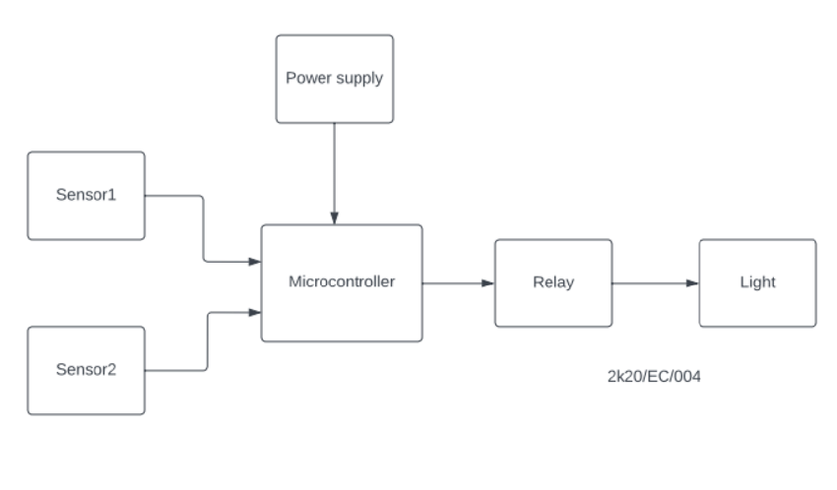
BLOCK DIAGRAM

Slide 7
DESCRIPTION
Infrared sensors - These work based on the principle of detecting changes in infrared radiation levels. They consist of an emitter and a receiver. The emitter emits infrared radiation, and the receiver detects any variations in the received radiation.
Microcontroller - Controls the system, processes sensor data, and manages the visitor count.
Power supply - Provides the necessary voltage for the system's operation .
Relay - A relay can be employed to turn the 7-segment LED display on and off, conserving power during idle periods to prolong the display's lifespan.
LCD Display – This is one kind of electronic device used to display messages and data . It has 16 columns and 2 rows which can display 32 characters in total. These devices are low cost and programmer – friendly.

Slide 8
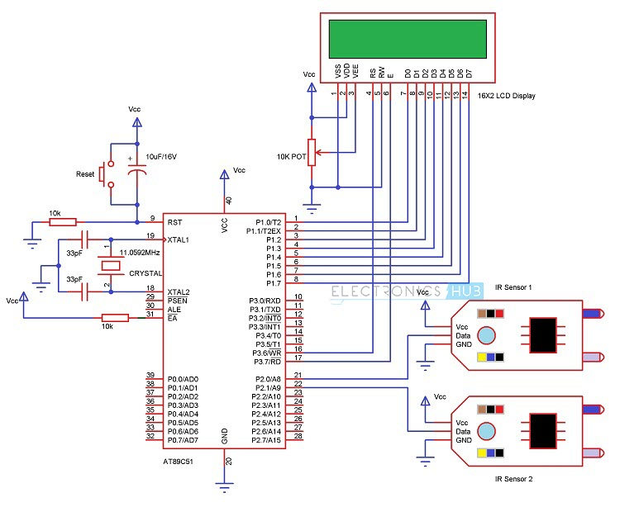
CIRCUIT DIAGRAM

Slide 9
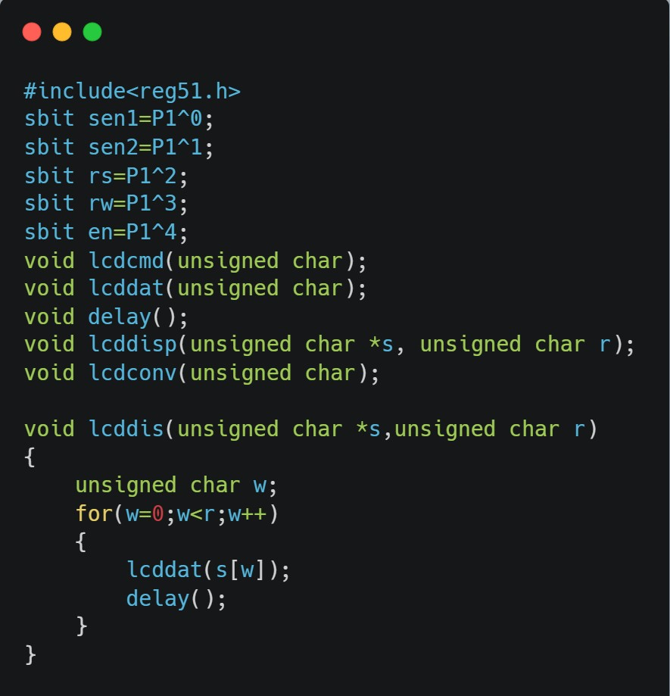

CODE

Slide 10


CODE

Slide 11
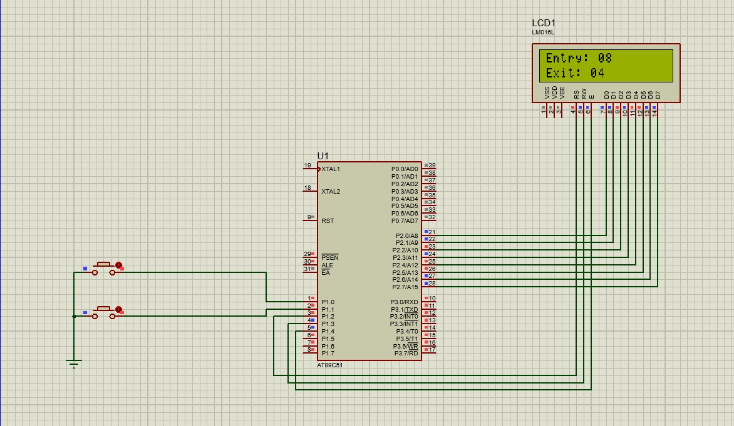
SIMULATION

Slide 12
FUTURE SCOPE AND WORK
Future work could focus on optimizing power consumption, addressing limitations, and introducing features like wireless data transmission for remote monitoring.
Machine learning algorithms can also be used as AI-powered systems can better distinguish between humans and inanimate objects.
In this post-pandemic world , bidirectional counter counters can be used in hospitals with more advancements like mask detection to ensure safety measures between patients.
Businesses can anticipate peak visiting times , plan staffing accordingly to optimize company’s profit .
Bidirectional visitor counters can be connected to smart phones , laptops or PCs which will allow real-time data sharing and automation. As for instance , a retail shop can adjust lighting and temperature settings according to crowd automatically.

Slide 13
Conclusion
The bidirectional visitor counter system, built upon the 8051 microcontroller and calibrated infrared sensors, consistently detects and counts visitors.
The user interface, displayed on an LCD unit, provides a straightforward means of interpreting visitor data, emphasizing the design's simplicity for easy use and monitoring.
The implementation's user interface, manifested through the display unit, provides a straightforward and accessible means of interpreting visitor data.
The display unit accurately reflects real-time visitor counts, providing a tangible output for monitoring foot traffic.

Slide 14
REFERENCES
Design and Implementation of a Bi Directional Visitors counter
Raji Ololade
Bidirectional Counter using Microcontroller and IR sensor
Techatronic
Bidirectional Visitor Counter | 8051 Microcontroller
Rishabh Gupta

